Slide 1
Patterns of Growth and Foraging by Chinook and Coho Salmon in Three Geomorphically Distinct Sub-basins of the Kenai River
Benjamin Meyer¹, Daniel Rinella², Erik Schoen³, and Mark S. Wipfli⁴
¹School of Fisheries and Ocean Sciences, University of Alaska Fairbanks, Fairbanks, Alaska 99775; bemeyer@alaska.edu
²Alaska Center for Conservation Science and Department of Biological Sciences, University of Alaska Anchorage, Anchorage, Alaska, 99508; djrinella@uaa.alaska.edu
³Alaska Cooperative Fish and Wildlife Research Unit, University of Alaska Fairbanks, Fairbanks, Alaska 99775; eschoen@alaska.edu
⁴ U.S. Geological Survey, Alaska Cooperative Fish and Wildlife Research Unit, Institute of Arctic Biology, University of Alaska Fairbanks, Fairbanks, Alaska 99775; mwipfli@alaska.edu

Slide 2
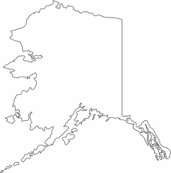
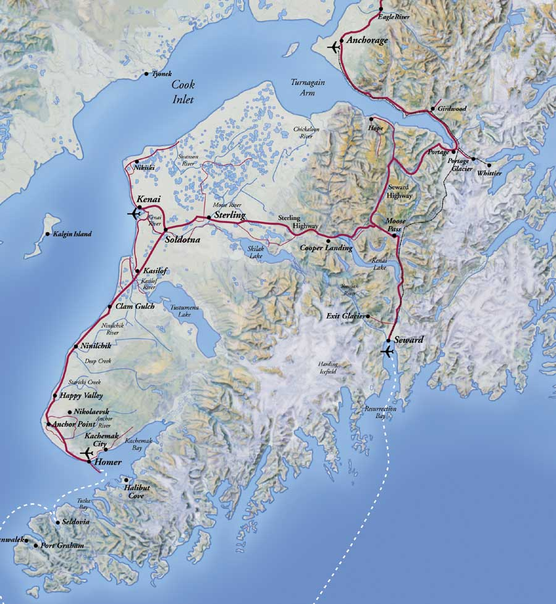
Alaska’s Kenai Peninsula
Notes:
Ben

Slide 3
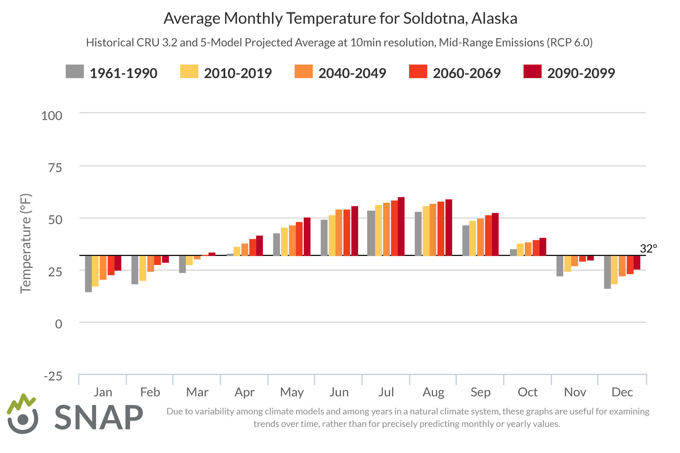
The Kenai Peninsula is predicted to get warmer…
Notes:
Ben Note: warmer temperatures year round

Slide 4
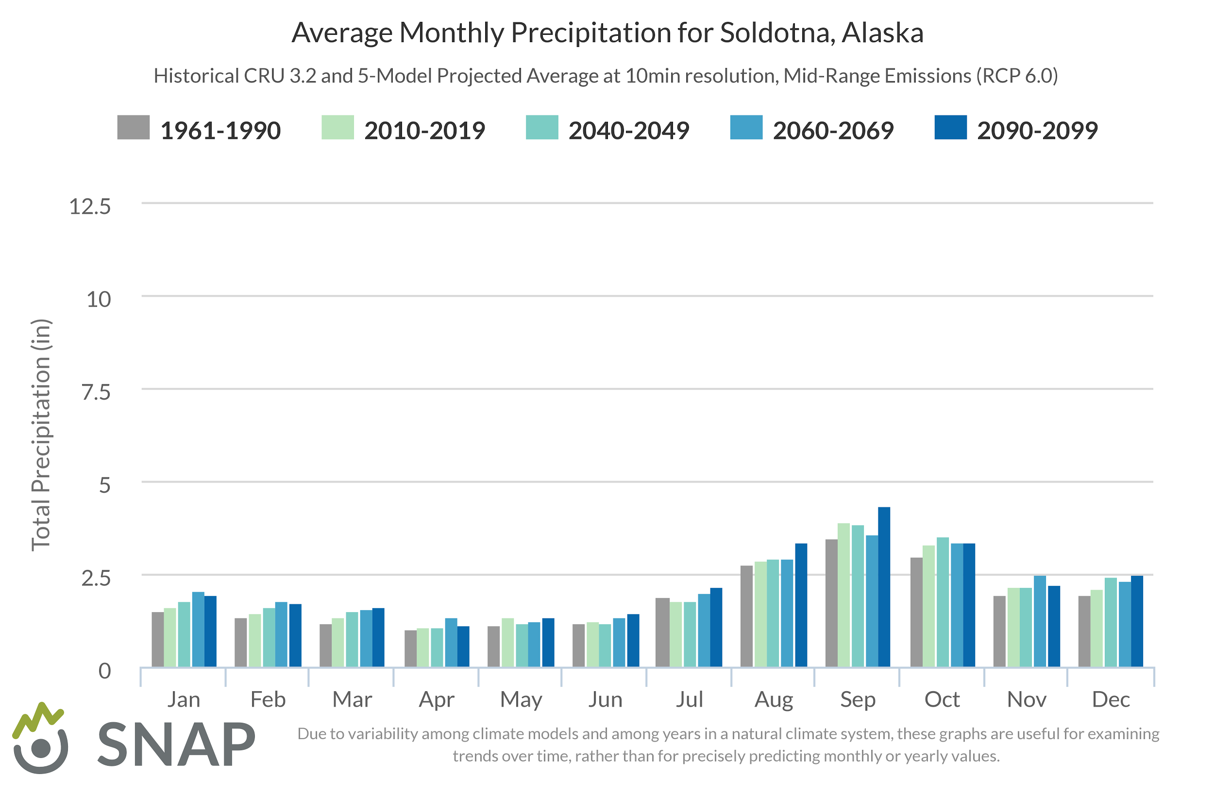
And wetter….
Notes:
Ben

Slide 5
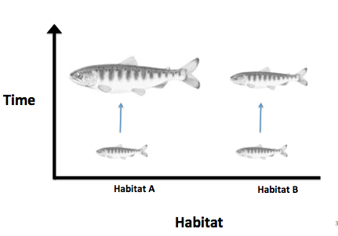
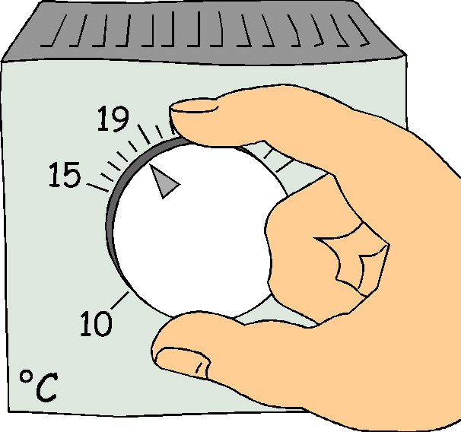
How could a shift in climate regime affect juvenile salmon rearing habitat?
→ Climate change will affect different habitats in different ways...
Drivers
Habitat Changes
Responses
Notes:
Ben

Slide 6
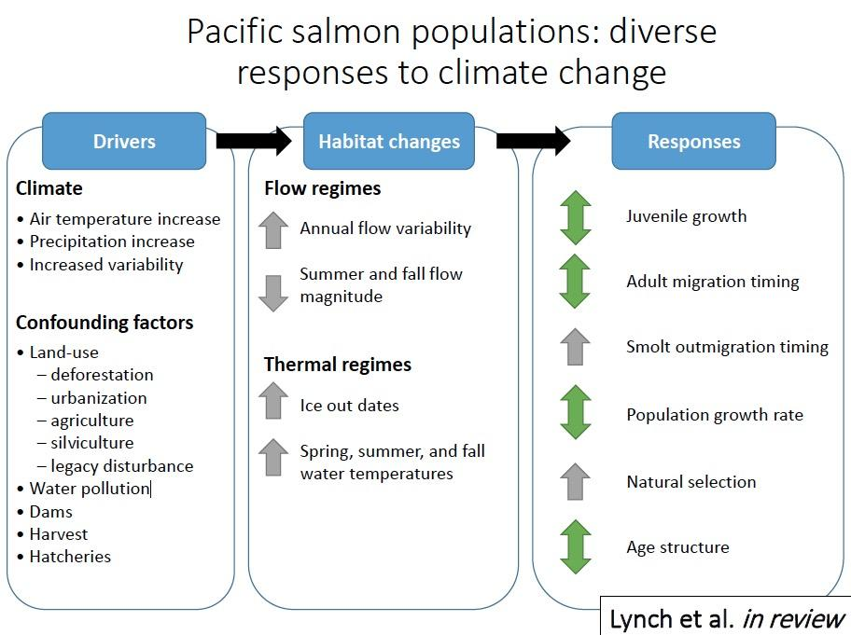
How could a shift in climate regime affect juvenile salmon rearing habitat?
Drivers
Habitat Changes
Modified from Lynch et al. 2015
Slide courtesy Jeff Falke
Notes:
Almost all confounding factors are absent in the Kenai watershed, except for harvest of adult salmon

Slide 7
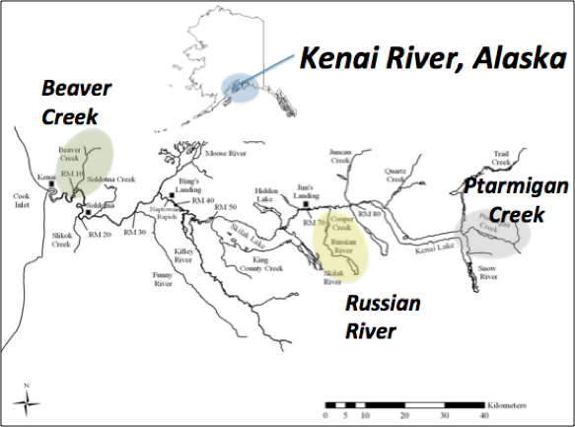
The Kenai River Watershed - Diversity of Landscapes

Slide 8
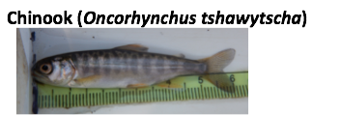
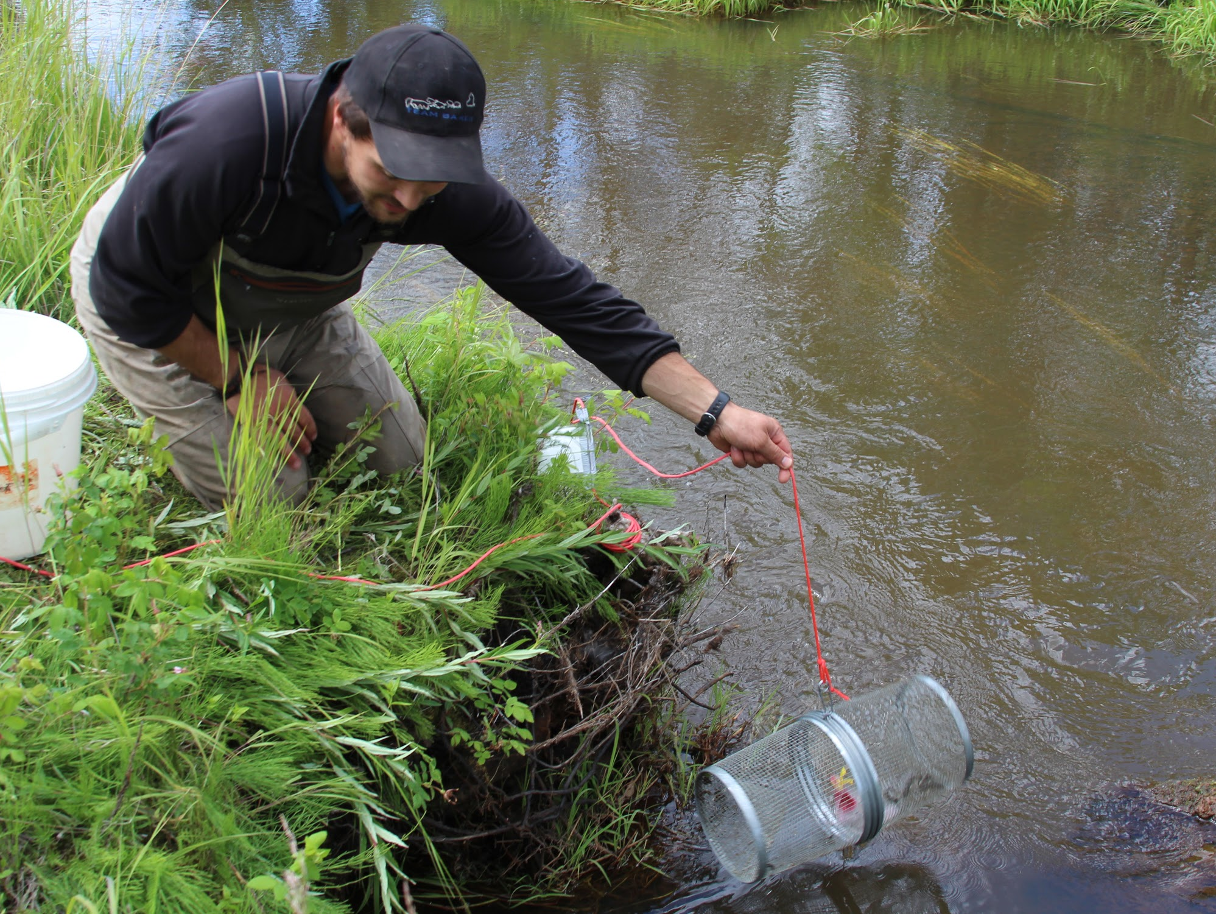
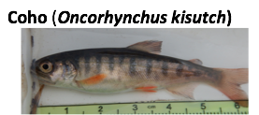
The Kenai River Watershed - Diversity of Landscapes
Juvenile Salmon rearing habitat is found throughout the watershed.

Slide 9
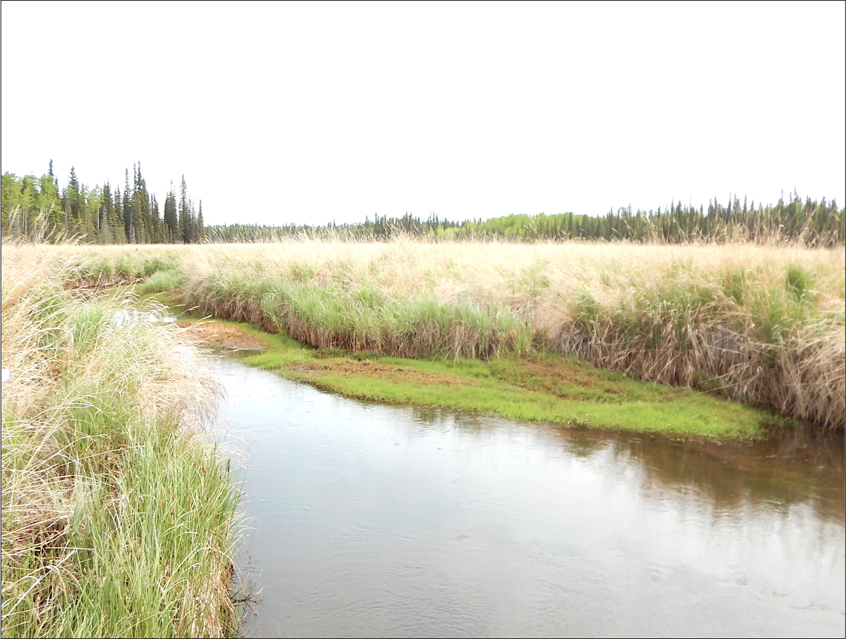
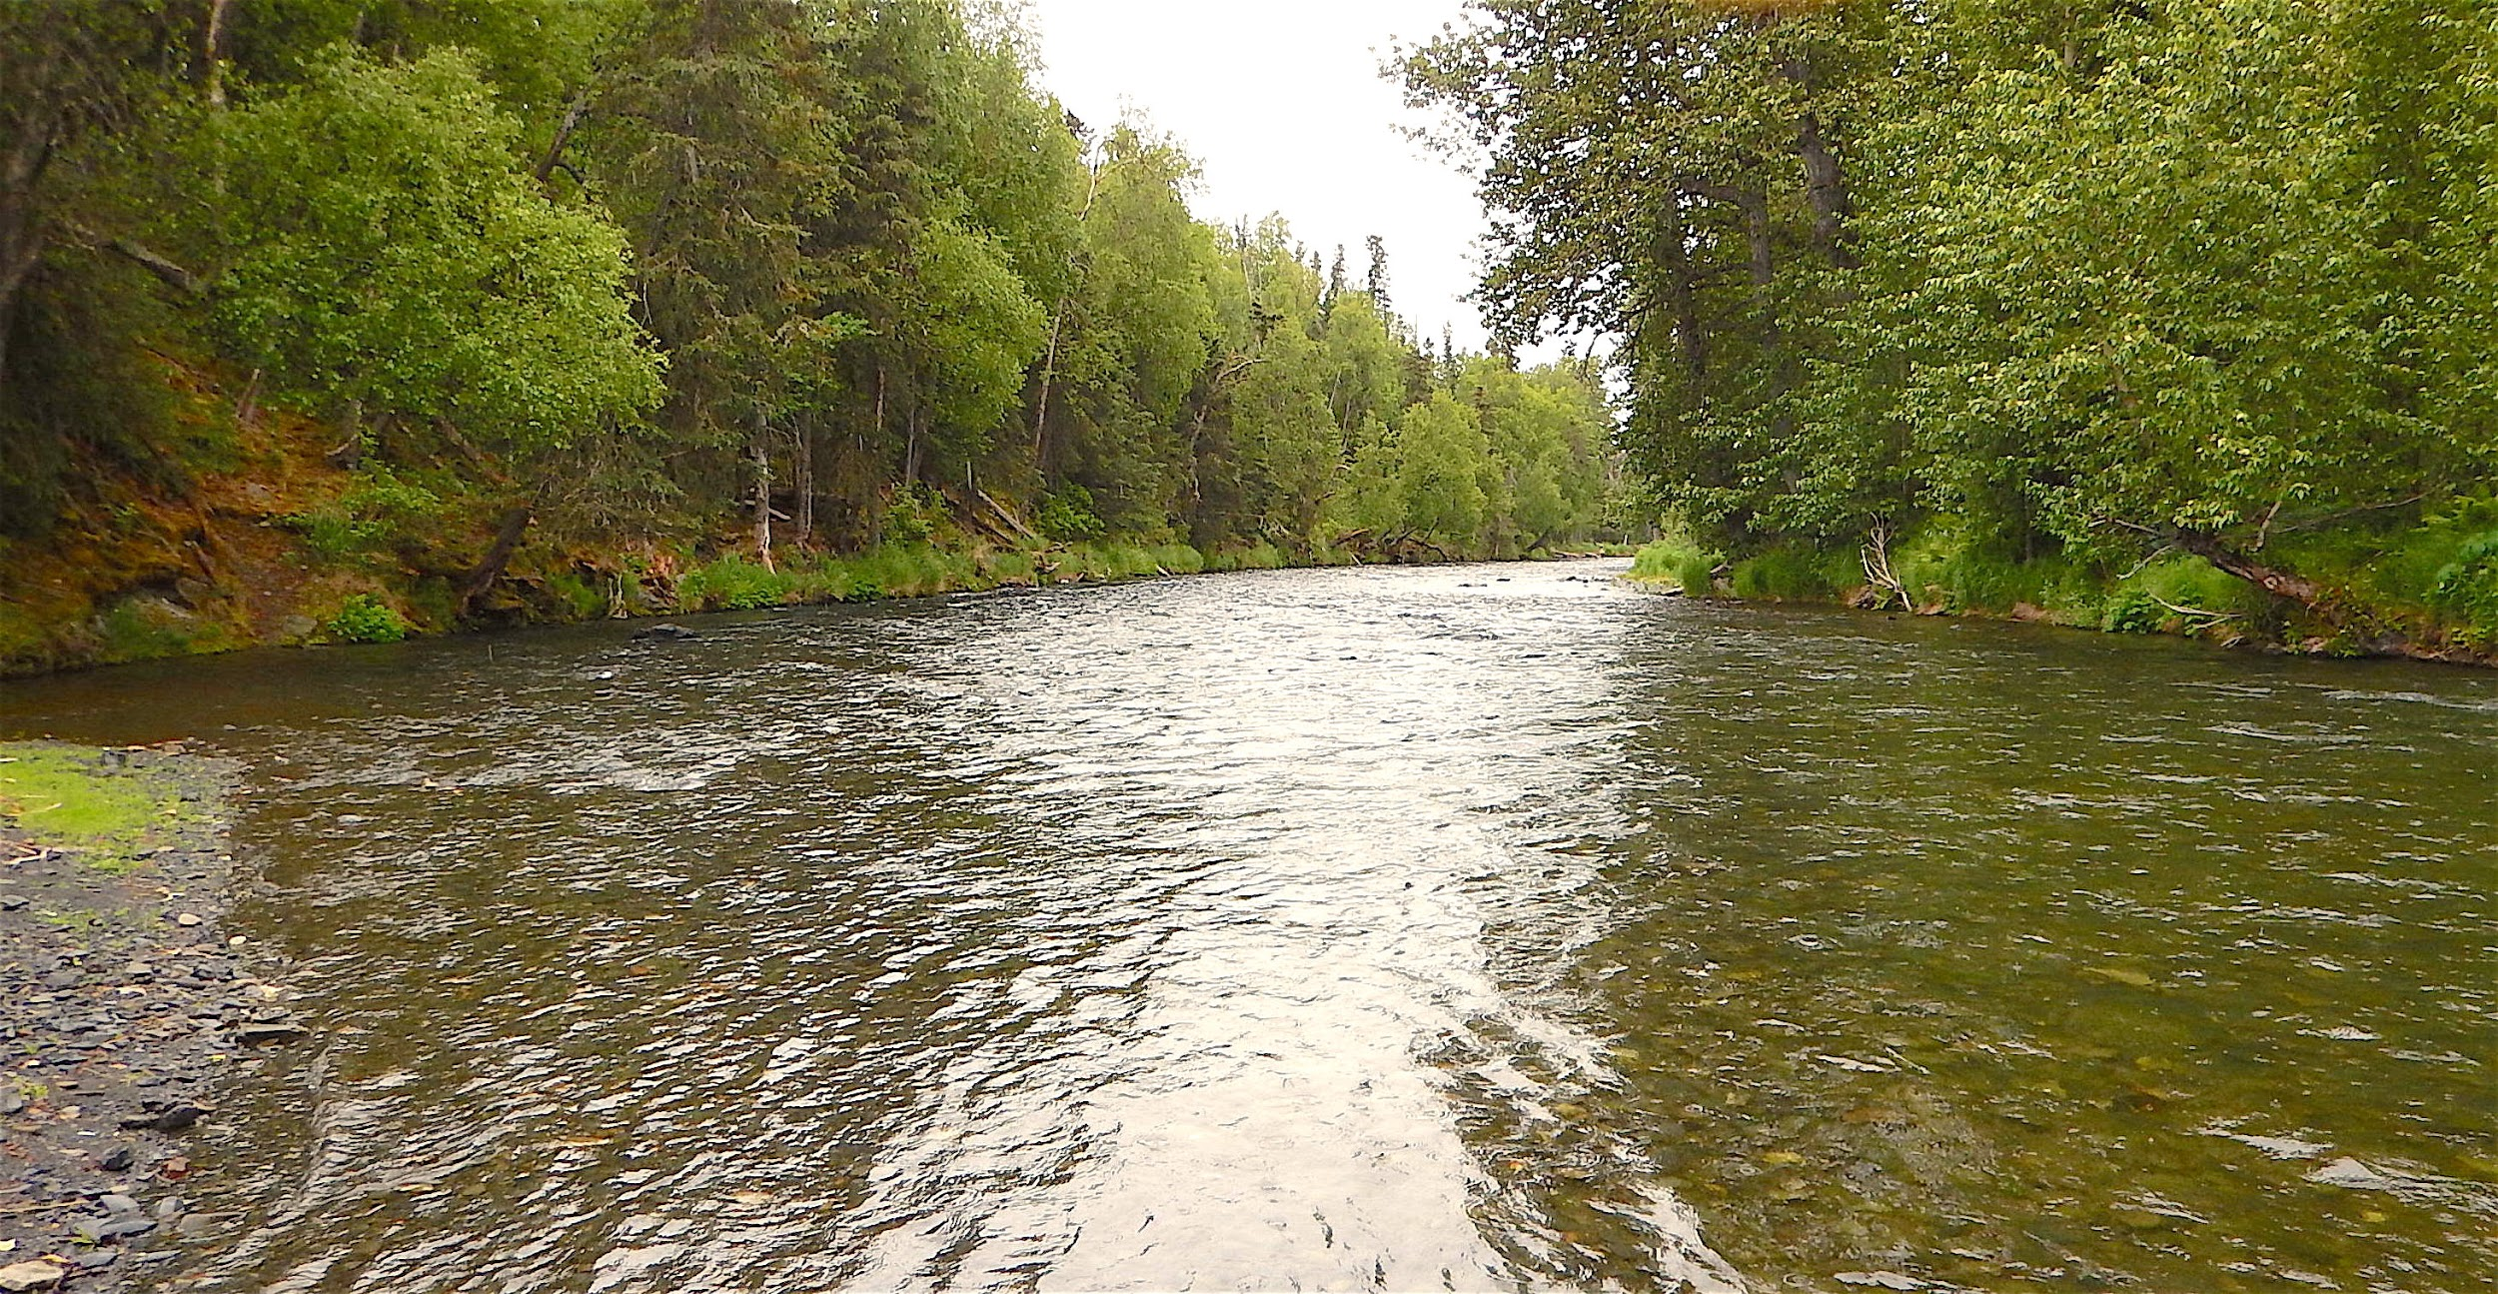
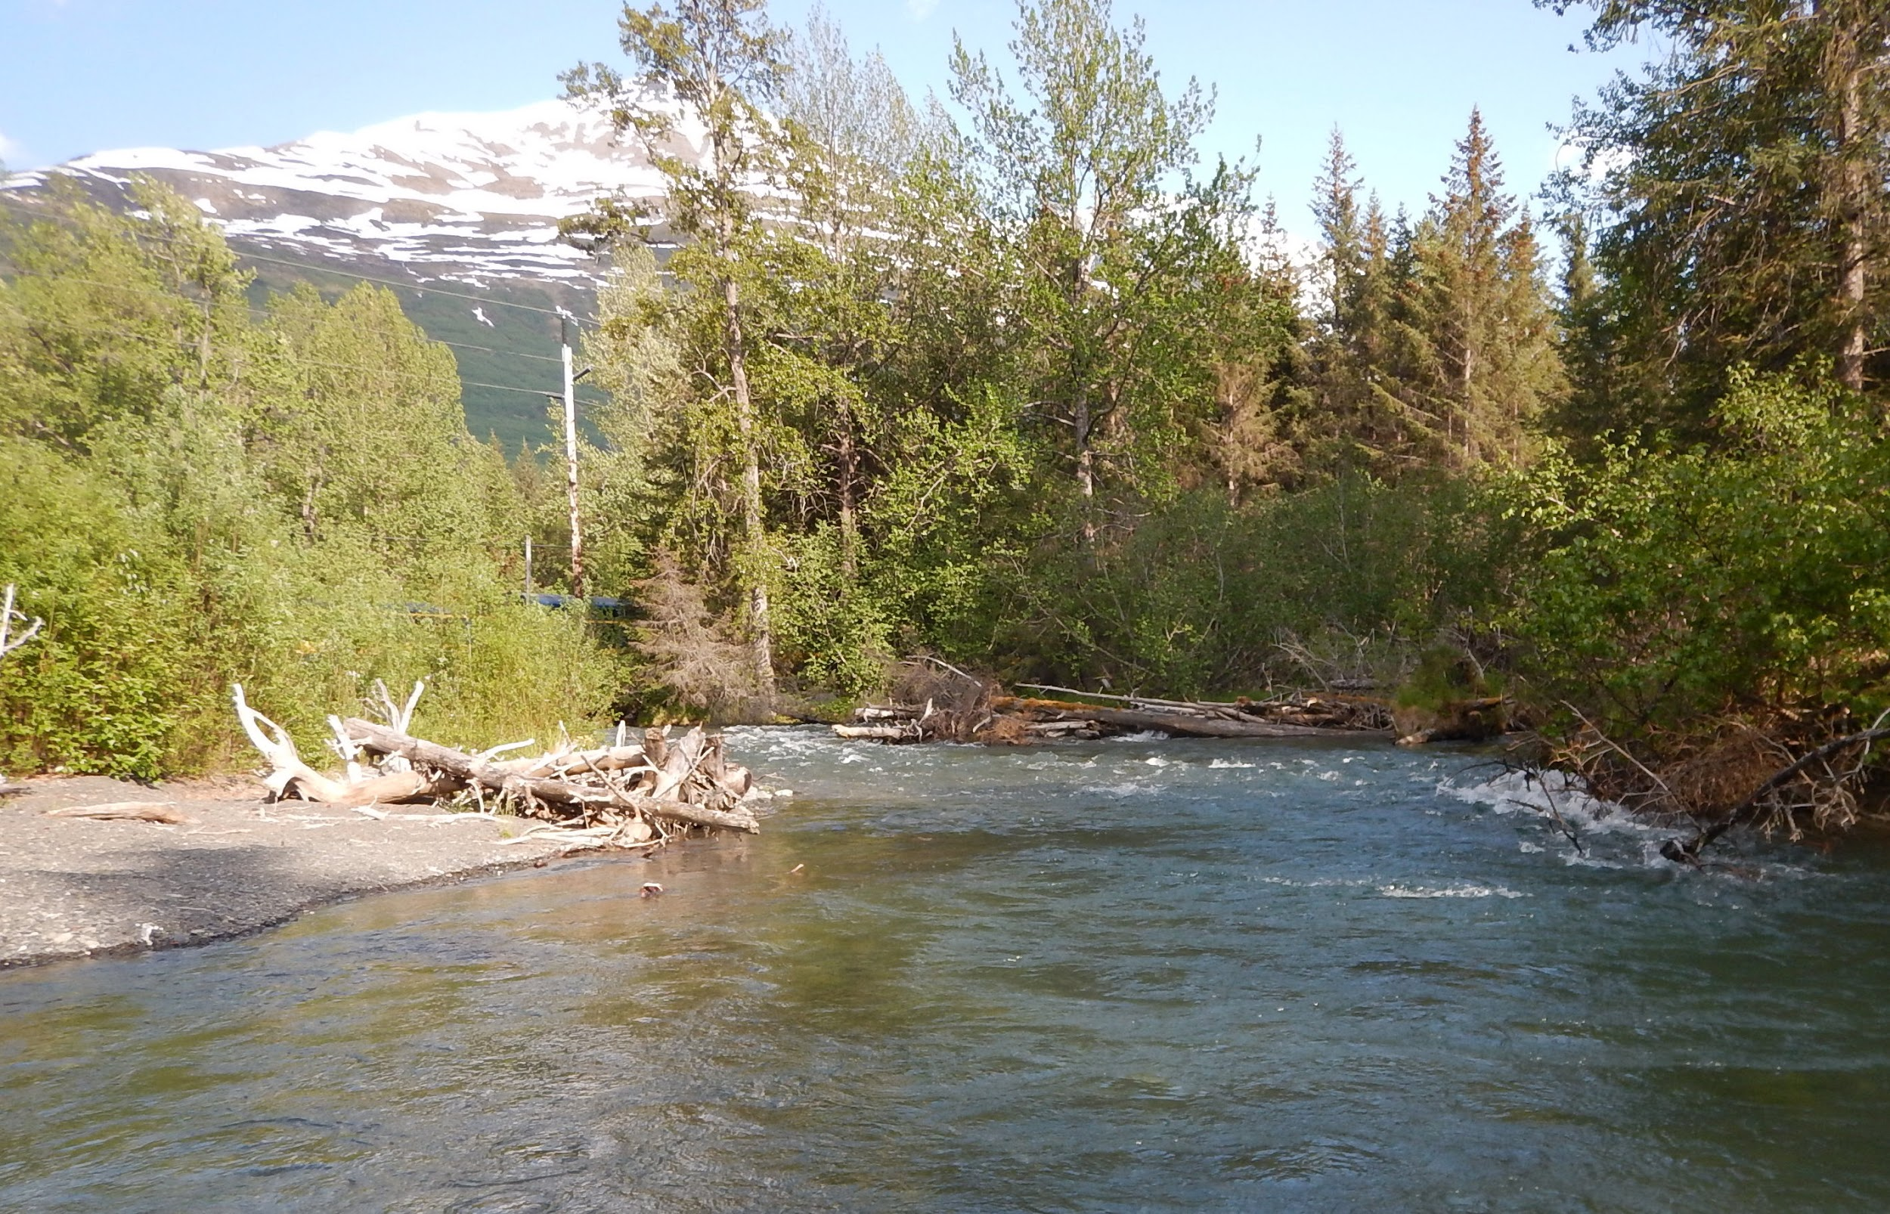
Climate change will affect different habitats in different ways...

Slide 10
Questions
At the watershed scale, what is the sensitivity of water temperature to air temperature?
How could a change in thermal regime affect juvenile Coho and Chinook growth rates?

Slide 11
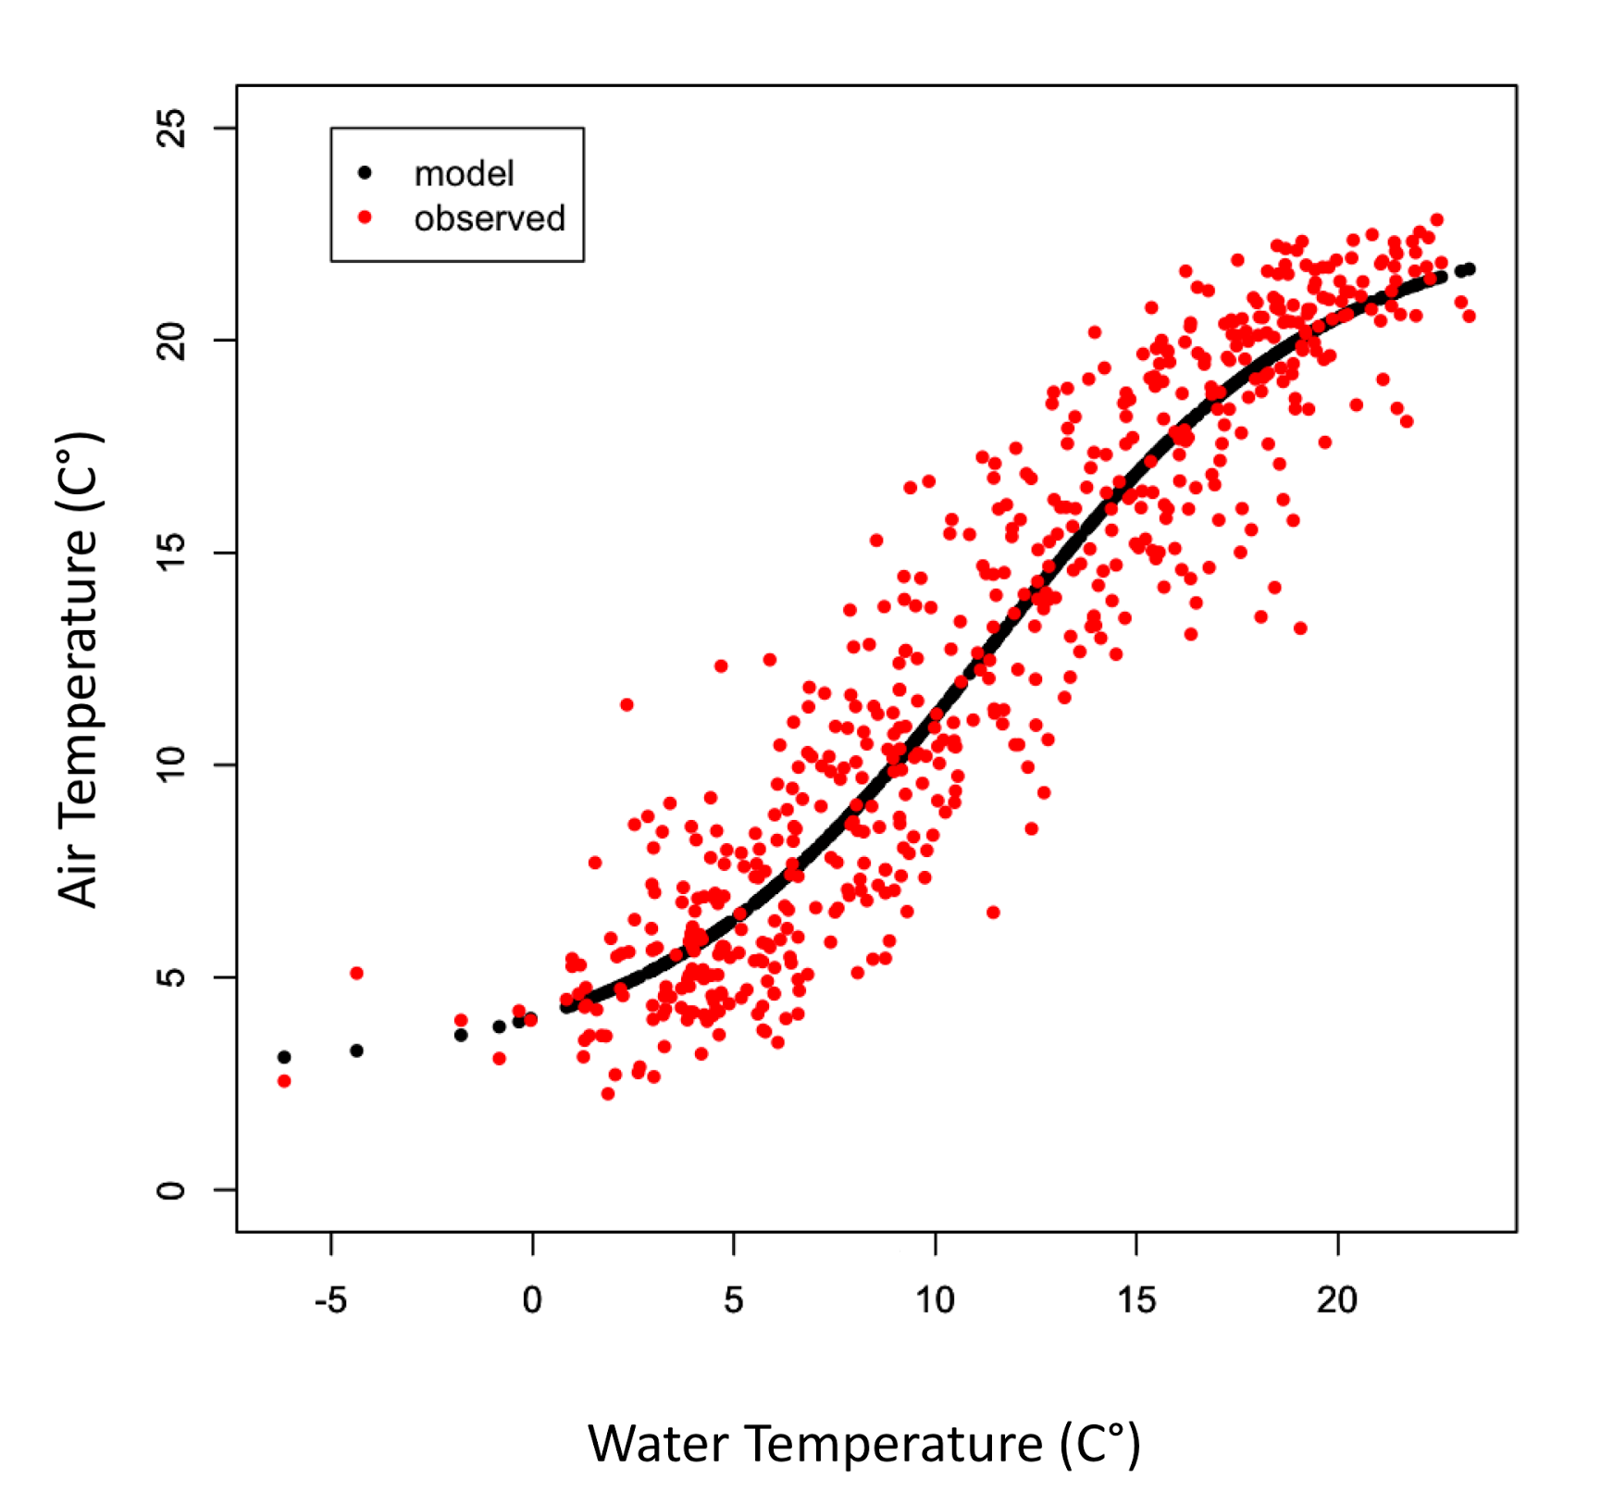
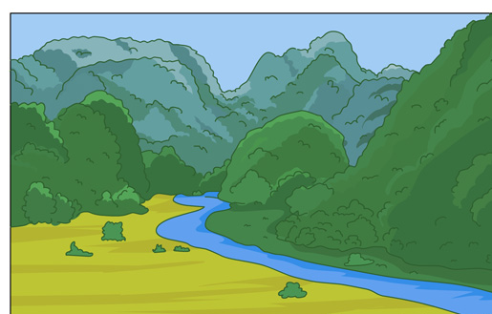
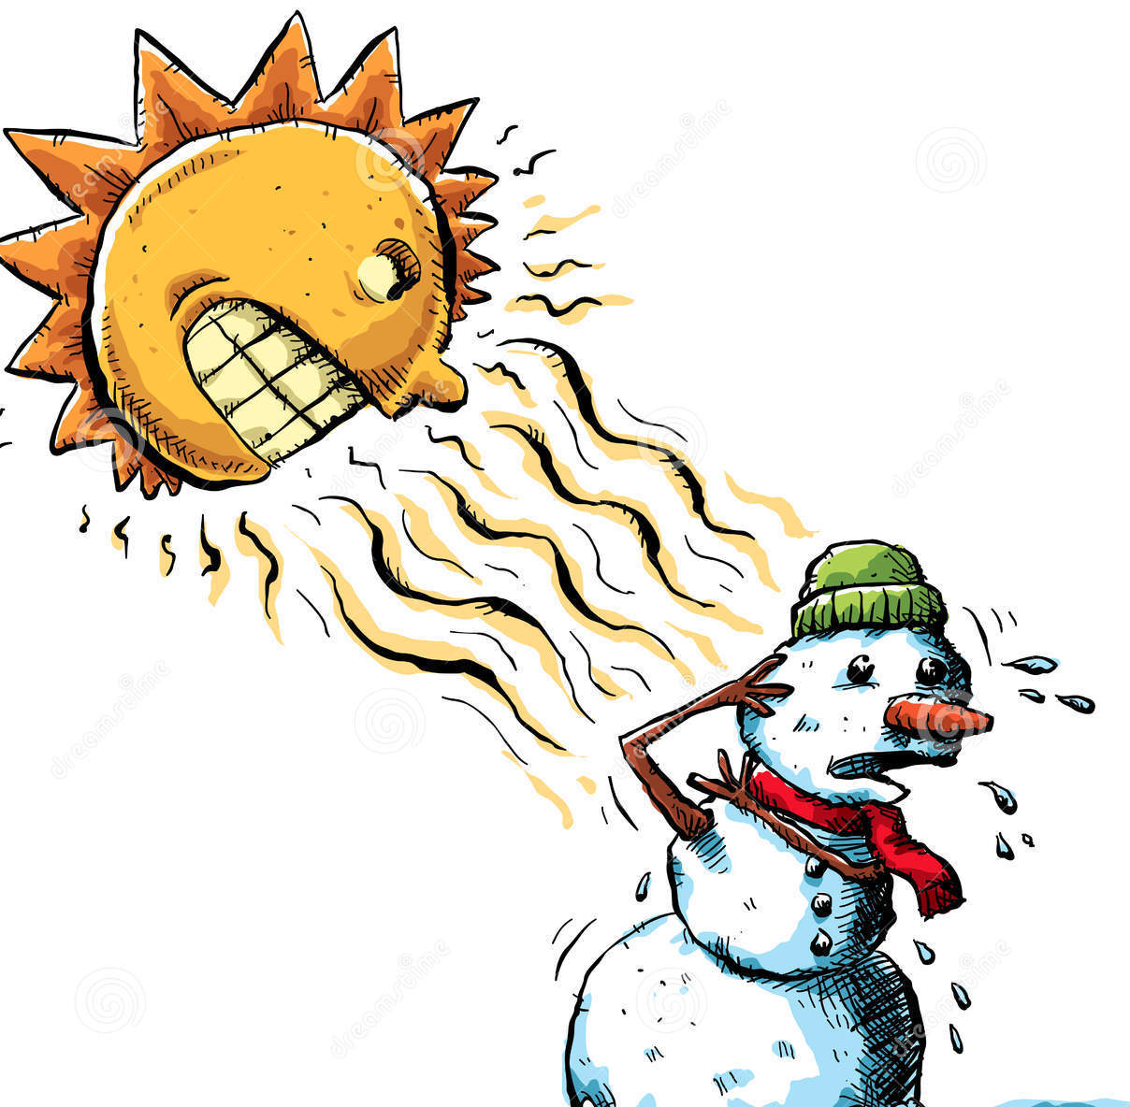
Hypothesis: Landscape mediates the influence of climate change
Objective 1: Air and Water Temperature Relationships
Hypothesis 1.1
At the scale of individual watershed, “thermal sensitivity” of water temperature to air temperature will be lower in places and times where snow and glacial melt inputs are proportionately lower.
Thermal Sensitivity
Geomorphic
Factors
Meteorologic Factors
Hydraulic Factors
∝
Water Temperature
Probably lots more!
Air Temperature
Valley Slope
Elevation
Watershed Area
Gradient
Wind
Humidity
% Ice Cover
% Lake Cover
Annual Snowpack
Notes:
Mention preliminary results from

Slide 12
Hypothesis: Landscape mediates the influence of climate change
Objective 1: Air and Water Temperature Relationships

Slide 13
Hypothesis: Landscape mediates the influence of climate change
Objective 2: Growth and Bioenergetics Relationships
Hypothesis 2.1
As water temperatures in the Kenai River watershed respond to a warming climate, juvenile Chinook and Coho Salmon populations may experience shifts either towards or away from thermal conditions optimal for somatic growth.

Slide 14
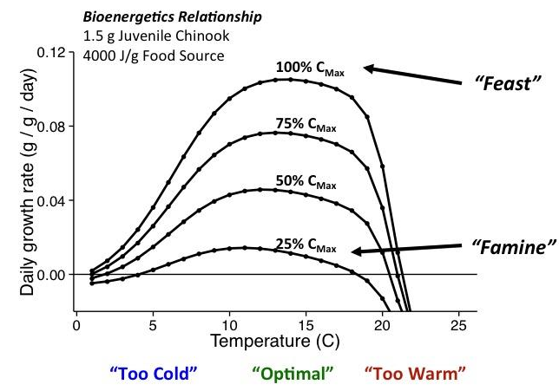
Hypothesis: Landscape mediates the influence of climate change
Objective 2: Growth and Bioenergetics Relationships
Where do our study populations fall in terms of their food and temperature experience?
Figure modified from D. Beauchamp and E. Schoen

Slide 15
Hypothesis: Landscape mediates the influence of climate change
Objective 2: Growth and Bioenergetics Relationships
Theoretical Results.
Anticipated different food and temperature conditions in study populations.
Data from 2015 & 2016 will be used to test hypotheses.

Slide 16
Potential Implications
Temperature-limited populations that reside in thermally sensitive watersheds may see the largest changes in growth rate as a result of changes in water temperature regime.
Potential effects of a water temperature regime shift on juvenile salmon growth rates will be mediated by diet.
Some watershed features may be more significant than others in buffering changes in thermal regime.

Slide 17
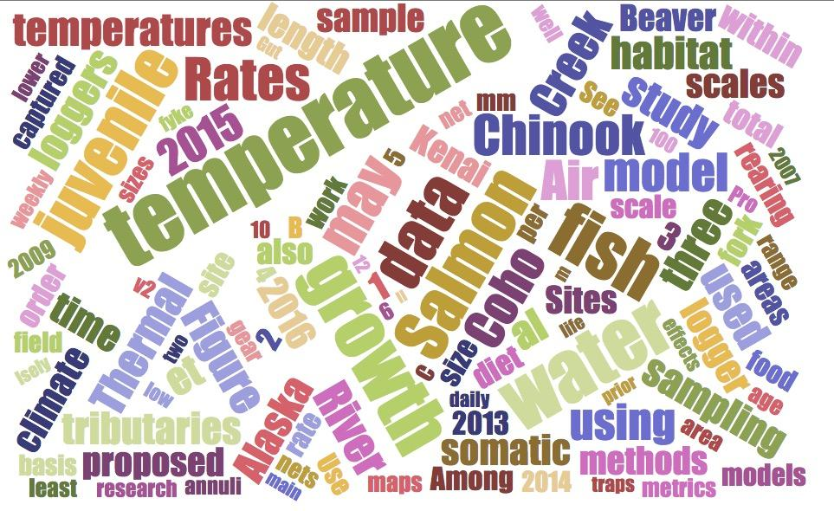
Questions?
Word cloud generated from thesis proposal draft.

Slide 18
Supplemental Information
Tributary Name | Watershed Area | Average Gradient | Elevation at Mouth | % Lake Cover in Watershed | % Ice Cover in Watershed | Total Length
 | km^2 | % | m | % | % | km
Beaver Creek | 157 | 1.6 | 0 | 1.96% | 0.00% | 58
Tributary Name | Watershed Area | Average Gradient | Elevation at Mouth | % Lake Cover in Watershed | % Ice Cover in Watershed | Total Length
 | km^2 | % | m | % | % | km
Russian River | 163 | 9.2 | 106 | 3.58% | 0.52% | 90
Tributary Name | Watershed Area | Average Gradient | Elevation at Mouth | % Lake Cover in Watershed | % Ice Cover in Watershed | Total Length
 | km^2 | % | m | % | % | km
Ptarmigan Creek | 86 | 13.9 | 133 | 3.11% | 6.82% | 43

